Slide 1
Transferring files to SQL and back
Peter Blanchfield

Slide 2
What are we trying to do?
We are now at the point of trying to use the data on a csv
To fill our database
You should be careful not to waste time when programming
Don’t get too complex
Trying to solve future problems
However, I think this could be a useful process to try and generalise

Slide 3
Computational Thinking (CT)
This can be thought of as thinking like a programmer
We try to apply certain principles to every program we write
Analyse the problem
Break it down into steps
Come up with an algorithm
Look out for generalisations

Slide 4
Some data may already exist in other ways
For example I have built up an Excel file of what I have in my database
Description | OLD
Databases, Interfaces and Software Design Principles | G54DIS
Databases and Interfaces | G51DBI
Software Engineering Group Project | G52GRP
Software Engineering Management | G54SPM
Industrial Experience | G53IND

Slide 5
The CSV File looks like this
Description, OLD
"Databases, Interfaces and Software Design Principles",G54DIS
Databases and Interfaces,G51DBI
Software Engineering Group Project,G52GRP
Software Engineering Management,G54SPM
Industrial Experience,G53IND

Slide 6
Reading the CSV can be done as we did
<html>
<head>
<title>Download my data to my database</title>
</head>
<body>
<?php
$file = fopen(“ModuleData.csv","r");
while($data = fgetcsv($file)){
// Save to the database
}
fclose($file);
?>
</body>
</html>

Slide 7
This time we read the file as a CSV
$data = fgetcsv($file)
$data will be an array
In our case $data[0] and $data[1]
The first row is the title row
$data[0] = ‘Description’;
$data[1] = ‘Old’;
I am going to modify the titles to be the fields I will use

Slide 8
In my database
I have a table (entity) called SaturnModules
It has two columns (attributes or fields)
id and description
So I change my csv
id,description
G54DIS,"Databases, Interfaces and Software Design Principles"
G51DBI,Databases and Interfaces
G52GRP,Software Engineering Group Project
G54SPM,Software Engineering Management
G53IND,Industrial Experience

Slide 9
Now on my first read
$data[0] = ‘id’ and $data[1] = ‘description’
The file it is saved in is still called ‘ModuleData.csv’
If it was called ‘SaturnModules.csv’ I can start to generalise more
Let us assume I am writing a more useful function
I can send this php file a $_POST variable
If I call it ‘file’ then I could say
$filename = $_POST[‘file’];
Or I could make use of another built in PHP type

Slide 10
From the w3c tutorial page (modified a bit)
<!DOCTYPE html>
<html>
<body>
<h1>Select your file <h1>
<form action=“./StoreCSVtoSQLTable.php">
Select a file: <input type=‘file’ name=‘file’><br><br>
<input type="submit">
</form>
</body>
</html>
The ‘file’ input type

Slide 11
StoreCSVtoSQLTable.php will generalise
I can pull the filename apart
$file = $_POST['file'];
Get the file name that has been posted
$end = strpos($file,'.');
Find the position of the extension ‘.’ using the strops function
String Position
$name = substr($file,0,$end);
Get the name part – the substring (substr) – of $file starting at character 0
Taking $end characters.

Slide 12
Generalising
$infile = fopen($file,"r");
Now we open the file as before
$data = fgetcsv($infile);
Get the first line of data from the file split up
$fields = $data;
And save it as the fields of the table

Slide 13
Generalising onwards
$ncols = sizeof($data);
The number of columns in the table will be the size of the array
while($data = fgetcsv($infile)){
… //So we go through the file starting on the next line
}
We can do a loop through the file building up an SQL insert command

Slide 14
SQL command we want
In the example case this will look like:
insert into SaturnModules (id,description) values (
'G54DIS‘
,'Databases, Interfaces and Software Design Principles’
)
So we start to build this string
$sql = “insert into” . $name. “(“ . $fields[0] . “,” . $fields[1] .”) values (‘” . $data[0]. “’,’” . $data[1] . ”’)”;
However, this is not really general

Slide 15
To generalise further I make a pair of for loops
One for the fields
$sql = "insert into " . $name . " (";
for($i = 0; $i < $ncols; $i++){
$sql .= $fields[$i];
if($i < $ncols-1 ){
$sql .= ","; //There are more fields (columns) to come
}
else{
$sql .= ") values ('"; // This is the last field (column)
}
}

Slide 16
One for the values
for($i = 0; $i < $ncols; $i++){
$sql .= $data[$i];
if($i < $ncols-1 ){
$sql .= "','"; //There are more values to come
}
else{
$sql .= "')"; // This is the last value
}
} // And this is the end of the while loop

Slide 17
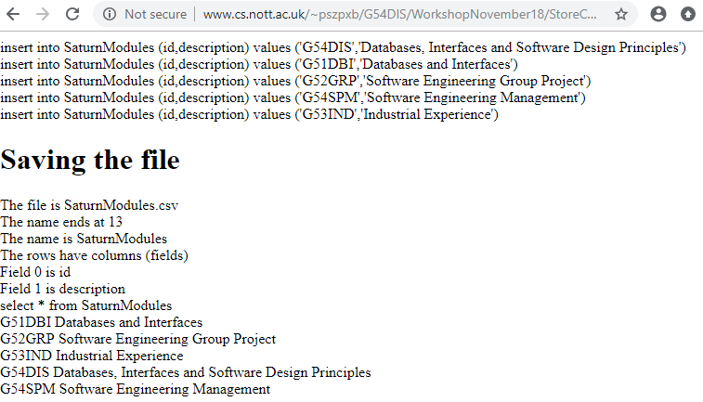
I added a few lines to make this output
I need a new file for my demo during the lecture. The database now has these entries

Slide 18
New file with still the same name
id,description
Q54DIS, “Dungeons, Incarceration and Spell Design Principles”
Q51DBI,Dungeons and Incarceration
Q52GRP,Guided Root Principles
Q54SPM,Spells Potions and Marketing
Q53IND,Incarceration Experience
Q5 is the code for the School of Wizardry in the Saturn codes

